Slide 1

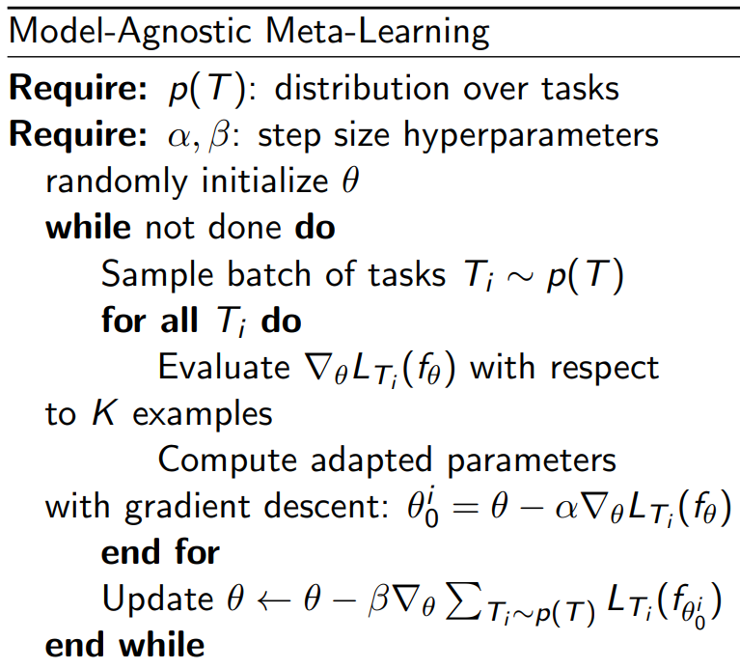
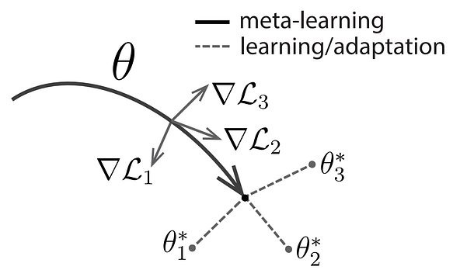
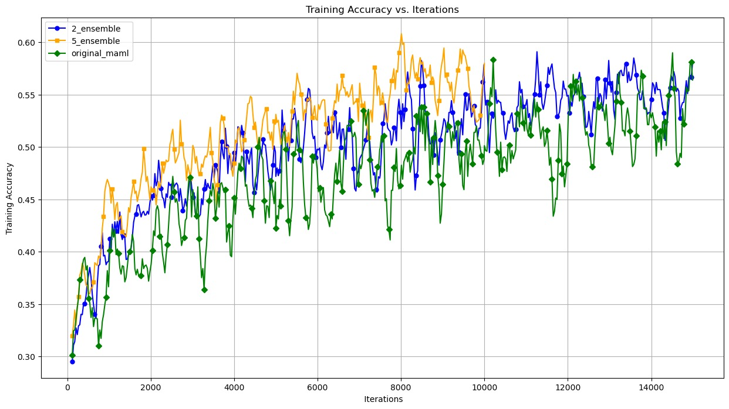
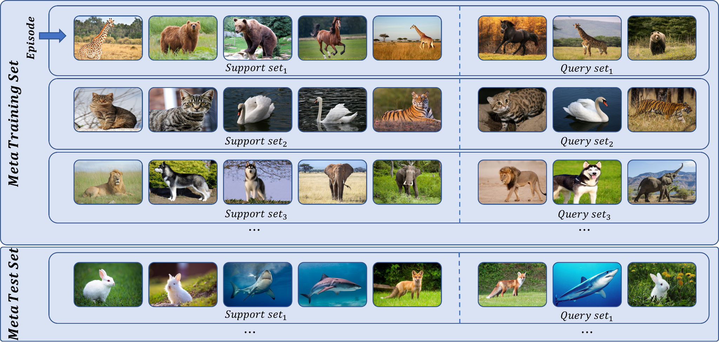
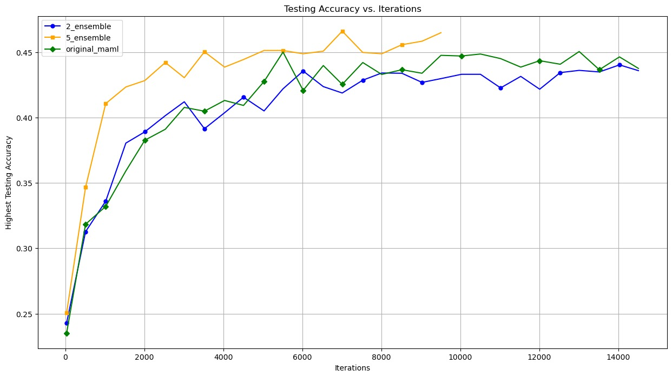
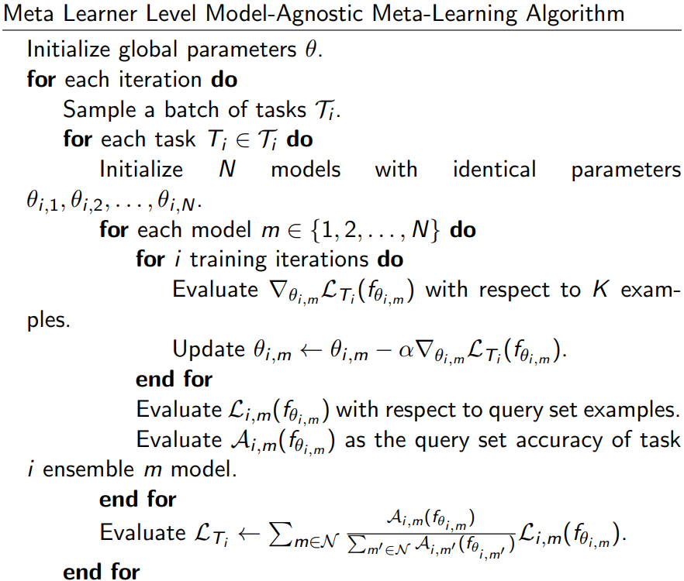
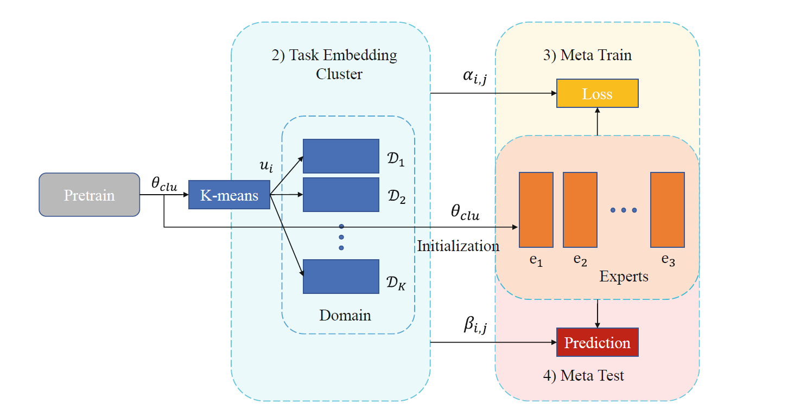

Synergetic Meta-Learning: Unleashing the Power of Ensembled MAML Models for Adaptive Learning and Generalization
Kevin Xu | Prince Kadiwar | Kamalendu Menon | Nidhi Roy John University of Ottawa
Background and Motivation
Original MAML Overview
Experimental Results
Conclusion and Future Work
Meta-learning, often referred as “learning to learn”, is a category that aim to enable models to adapt to new tasks rapidly and with minimal data.
PROBLEM:
MAML has grown in prominence because to its capacity to learn a proper initialization that enables for quick adaptation to different jobs.
MAML may not necessarily generalize well to a wide range of activities, particularly ones with large differences.
MAML is known for its difficulty to converge during its training.
MOTIVATION:
The merging of different models, known as ensembling, has been shown to improve overall model performance, stability, and resilience. Ensembling within MAML training process may help in:
Increase the generalization ability of MAML to diverse tasks
Prevent the disruption of extreme data during the training process to decrease the number of training iterations and stable the convergence of the algorithm
Model-Agnostic Meta-Learning (MAML) aims to train a model in such a way that it can quickly adapt to new, unseen tasks with only a few examples, by learning a good initialization of its parameters.
Dataset: MiniImageNet
Split: 80 classes in training set, 20 classes in testing set
Problem setup: 5-way 1-shot in support set, 15 images in query set, 5 gradient updates in training, 10 gradient updates in testing
Preprocessing: Image Normalization
Batch Loading: 4 tasks each batch/iteration, 2500 batches/iterations for 1 epoch
Conclusions:
Ensembling within MAML increased the performance for around 1%
Ensembling within MAML stabilized the convergence process, helping the algorithm increase the accuracy in earlier iterations
Ensembling within MAML costs much more computational resources since multiple models are trained for each task
Future Work:
Examine the algorithm with different settings: different number of ways/shots, different number of ensembles, different number of tasks for each iteration, different dataset
Implement different ensembling methods to replace the simple weighted average idea
Try the local ensembling idea on other types of meta-learners
Terminology
Literature Review
Research Approach
N-way: Number of classes to classify
K-shot: Number of samples for each one of the N classes
Support Set: The N-way K-shot “training set” for the learner to learn in the training process
Query Set: The “testing set” in training to reflect the learner’s learning
Methodology:
In this research we explore how ensembling techniques can be utilized when it comes to Meta-Learning/Few-Shot Learning. The implementation for this is quite unique in nature as compared with the traditional machine learning models as MAML involves local as well as global parameters.
Approach:
Initialize the global parameters for MAML
For each batch of task, initialize N models with identical local parameters. Within each task these local parameters are averaged out so that it does not overfit a particular task.
These local parameters are then used to update the global parameters. This helps MAML generalize better to new unseen tasks.
We have also tried experimenting with different model architectures including changing the base neural network and learning rates.
EEML: Ensemble Embedded Meta-learning (Li, Ren, & Wang, 2022)
EEML employs gradient-based meta-learning, organizes tasks into clusters, and utilizes a weighted voting mechanism during meta-test.
Advantages: Multi-expert cooperation enhances few-shot learning. Combines generic meta-learning with ensemble learning for improved results.
Disadvantages: Hyper parameter tuning may impact effectiveness. Higher computation complexity as training several MAML learners in parallel
Model-Agnostic Meta-Learning for Fast Adaptation of Deep Networks (Finn, Abbeel, & Levine, 2017)
Introduce a versatile meta-learning approach that quickly adapts diverse neural network architectures to novel tasks.
Advantages: Adapting any gradient based methods. Fast adaptation with limited data. Generalization across different tasks.
Disadvantages: Sensitivity to hyperparameters. Requires a modest amount of task-specific data. Complexity in implementation.
References
C. Finn, P. Abbeel, and S. Levine. Model-agnostic meta-learning for fast adaptation of deep
networks, 2017.
Finn, C. (2017, July 18). Learning to Learn. Berkeley Artificial Intelligence Research Blog. Retrieved from https://bair.berkeley.edu/blog/2017/07/18/learning-to-learn/
Li, G., Ren, B., & Wang, H. (2022). EEML: Ensemble Embedded Meta-Learning. In R. Chbeir et al. (Eds.), WISE 2022, LNCS 13724, pp. 433–442. Springer Nature Switzerland. https://doi.org/10.1007/978-3-031-20891-1_31
L. Long. Maml-pytorch implementation. https://github.com/dragen1860/
MAML-Pytorch, 2018.
H. Gharoun, F. Momenifar, F. Chen, and A. H. Gandomi. Meta-learning approaches for fewshot
learning: A survey of recent advances, 2023.

